Slide 1
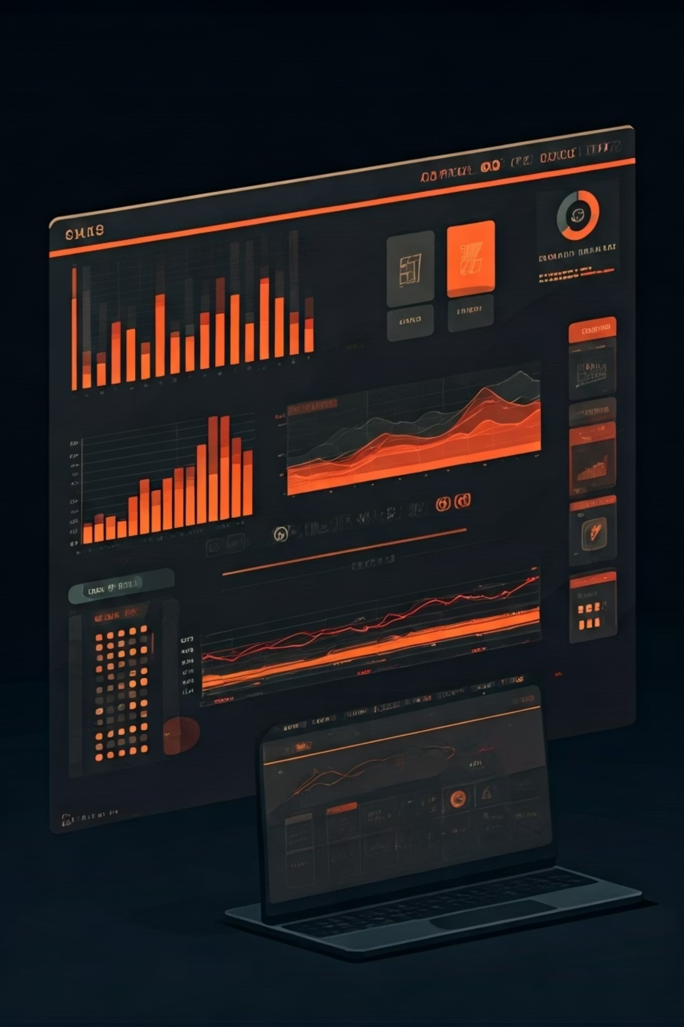
Interactive AI Sales Trend Analysis Dashboard using Excel
Transforming fragmented retail sales data into actionable insights through comprehensive, interactive analysis across regions, products, representatives, and customer segments.

Slide 2
Business Challenge
Fragmented Data
Limited Visibility
Lack of centralized sales data across regions, products, representatives, and customers
Difficulty identifying top-performing products and sales representatives
Customer Insights Gap
Financial Analysis
No clear view of buying patterns, especially between new and returning customers
Finance team needed quick profit margin analysis across products and regions
The business needed a single interactive dashboard for data-driven sales decisions to transform fragmented data into actionable insights.

Slide 3

Project Objectives & Scope
Dataset & Methodology
Dashboard Design Process
Objectives
Key Data Dimensions
Create centralized dashboard for multi-dimensional sales analysis
Order ID
Visualize trends, profitability, top products, representatives,
and customer segments
Data cleaning and structuring
Sales Representative
Enable interactive data filtering by region, product, representative,
and customer type
Pivot tables and charts creation
Region
Product Category
Provide rapid, actionable insights for optimizing sales strategy
Calculated fields for KPIs
Units Sold
Scope
Filtering implementation
Price
Comprehensive analysis of sales data across all company regions, products, time periods, and customer segments to provide a complete view of business performance.
Visualization design
Margin
Customer Type
Integration into cohesive
dashboard
Payment Method
Delivery Status

Slide 4
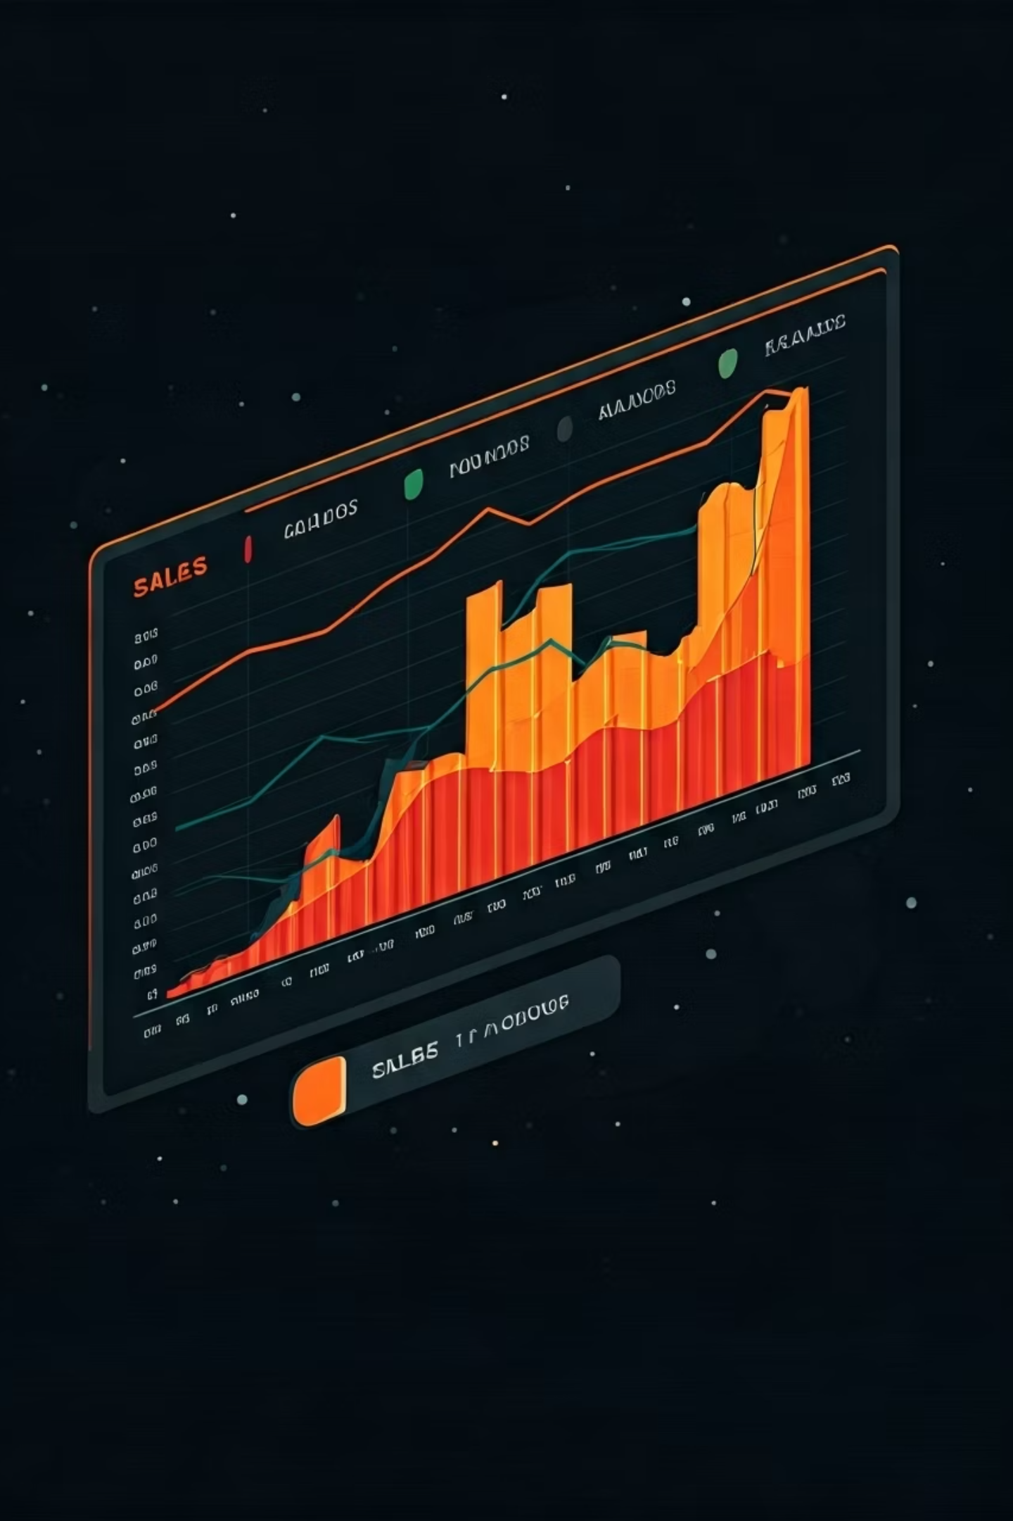



Sales Trend Analysis
Monthly Trends
Clear sales peaks in Q4 and steady growth throughout the year
Seasonality
25% increase in sales during holiday seasons with product category shifts
Growth
18% year-over-year growth with stronger performance in new regions
Key Insight: Sales promotions in traditionally slower months (March, August) significantly increased revenue.

Slide 5
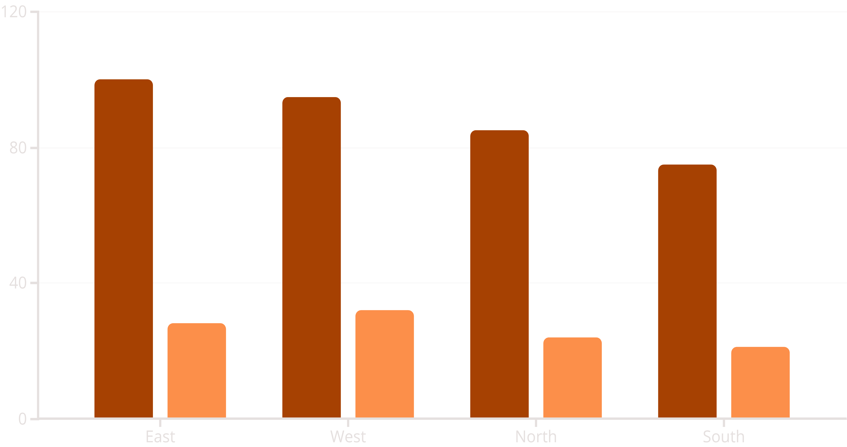
Regional Performance Analysis
Total Sales
Profit
Sales Volume
Profit Margin %
East and West regions lead in revenue, while North (+18%) and West (+15%) show fastest growth. The Southern region shows 8% decline in year-over-year performance, requiring targeted intervention.
Key Insight: Seasonal patterns vary significantly by region, with summer peaks in South and winter peaks in North.

Slide 6
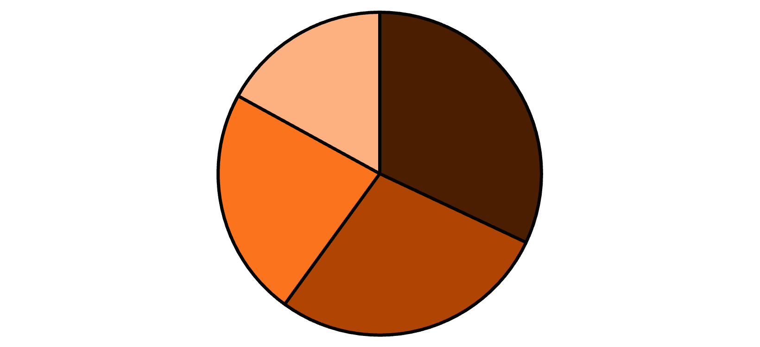
Product Performance Analysis
Key Product Insights
Premium Office Chairs and Smartphones were highest-selling individual products
Accessories category maintained highest margin at 45%
Home Office Equipment showed fastest quarterly growth at 23%
Mid-range products ($100-$500) delivered best balance of volume and margin
Electronics
Furniture
Home Office
Accessories
Seasonal products showed 15% lower performance outside peak periods

Slide 7
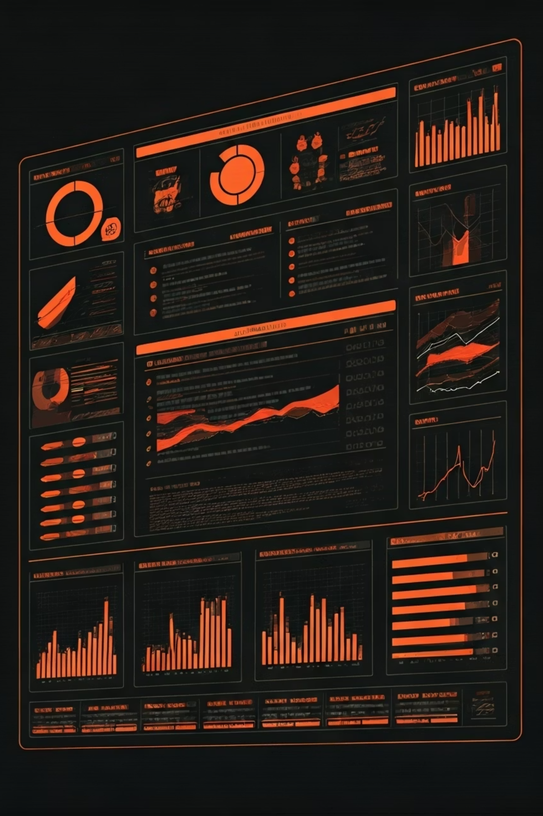
Sales Representative Performance
Top Performers
Leaderboard highlighting top sales representatives by revenue, units sold, and profit margin
Regional Specialization
Cross-tabulation of representatives vs. regions to highlight specialization strengths
Product Expertise
Identified product categories where individual representatives excel, guiding training opportunities
Team Performance
Compared team aggregates to identify collaborative success patterns and coaching opportunities

Slide 8


Customer Insights Analysis
Customer Segmentation
Buying Behavior
Returning customers have 2.3x higher average order value
68%
Returning customers purchase 40% more products per transaction
Credit card is preferred payment method (65%)
Returning Customers
Generate 73% of total revenue
Premium customers select express shipping 3x more frequently
Key Insight:
Customer loyalty programs should target the 32% new
customers to convert them to higher-value returning customers.
22%
Premium Customers
Contribute 47% of total profit margin

Slide 9
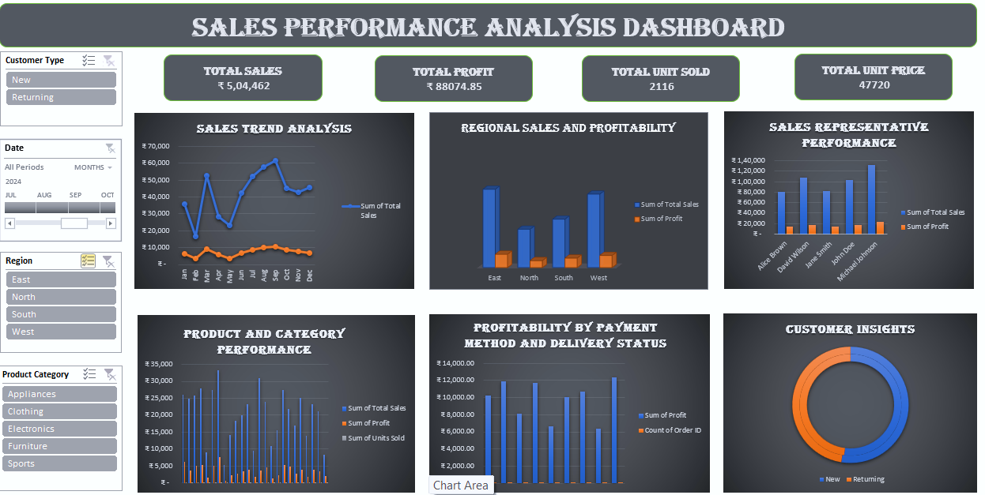

Slide 10
Recommendations & Impact
Focus on High-Margin Products
Regional Strategy Adjustment
Prioritize marketing for premium product categories (42% margin) over budget categories (18% margin)
Address Southern region's 8% decline with targeted interventions based on Eastern region's success (37% margins)
Sales Team Optimization
Customer Loyalty Program
Implement top rep sales strategies across underperforming teams, highlighting Rep Johnson's 39% average margin
Develop program based on returning customer insights to convert new customers to higher-value segments
The Sales Trend Analysis Dashboard transformed fragmented data into actionable business intelligence, providing a data-driven foundation for strategic decisions and operational improvements.

Slide 11
THANK YOU
LinkedIn : www.linkedin.com/in/arthi-subramani-analyst
Github : https://github.com/its-arthi/Sales-Trend-Analysis.git

